Slide 1
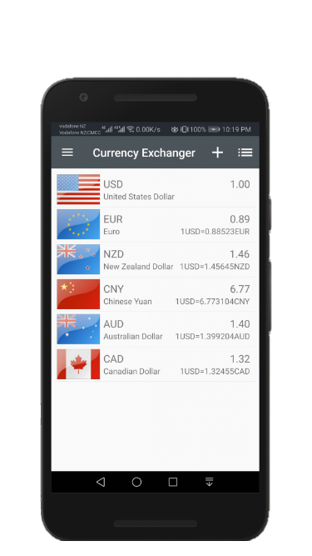
Currency Exchanger
Convert more than 150+ currencies
Support historical currency rates data
Set base currency freely
Free, easy, and fast

